Slide 1

Kuliah 1
Djoni Hartono – Universitas Indonesia
Research Cluster on Energy Modeling and Regional Economic Analysis

Slide 2
What is Energy Economics?
“Energy economics or more precisely the economics of energy is a branch of applied economics where economic principles and tools are applied to ‘‘ask the right questions’’ (Stevens 2000), and to analyse them logically and systematically to develop a well-informed understanding of the issues”

Slide 3
Energy Scarcity
There are three indicators that can be used to show the scarcity of energy resources, :
Engineering
Economics
Technological change
Energy economics is about allocating Scarce Resource, thus the microeconomic concerns of energy supply and demand and the macro-economic concerns of investment, financing and economic linkages with the rest of the economy form an essential part of the subject.

Slide 4
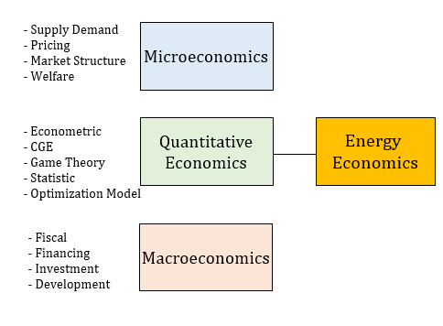
The Relation Between Energy Economic and Economics Dicipline
Notes:
Energy issues have been analysed from an economic perspective for more than
a century now. But energy economics did not develop as a specialised branch until
the first oil shock in the 1970s (Edwards 2003). The dramatic increase in oil prices
in the 1973–1974 highlighted the importance of energy in economic development
of countries. Since then, researchers, academics and even policymakers have taken
a keen interest in energy studies and today energy economics has emerged as a
recognised branch on its own.

Slide 5
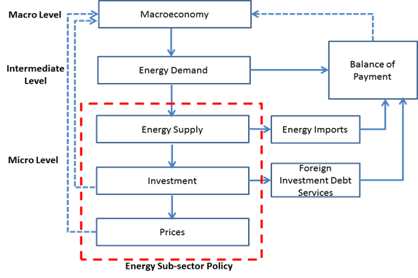
Energy and Economic Development
Forward Linkage
Energy supplies, investments and prices are determined which will be the basis for the estimated investment needed, foreign loans and imported energy requirements
Backward Linkage
The impact of energy sector
Micro level
It considers evaluations of energy supply, modeling and planning, risk management, project implementation, and also detailed evaluations of energy demand, modeling and management, pricing and non-price related policy tools.
Notes:
This framework shows the circular relationship of how energy and the economy influence each other. It is a complex work to isolate each element, and construct a logical model of the interaction of energy and economy (Munasinghe, 1980). The usual starting point is the projected GDP growth, which is followed by the demand for energy needed

Slide 6
Technological Change
Notes:
Technology are an important factor for knowing scarcity. Engineering estimation by using the amount of reserves and the ratio of reserves to production can be enlarged due to the influence of technological change. Technological applications can be aimed at accelerating depletion of reserves or increasing the amount of reserves.

Slide 7

Kebijakan Energi Nasional (KEN)
Permasalahan Energi
Tujuan, Sasaran & Arah KEN

Slide 8
PERMASALAHAN ENERGI
01
penggunaan energi belum efisien
02
subsidi energi belum tepat sasaran
03
harga energi belum sesuai harga keekonomian
04
minat investasi yang masih rendah
05
ketergantungan terhadap energi fosil masih tinggi tidak diimbangi peningkatan cadangan
06
keterbatasan infrastruktur energi
07
pengembangan infrastruktur energi belum didukung oleh industri nasional yang kuat dan mandiri
08
keterbatasan anggaran
09 Lemahnya keberpihakan terhadap produk teknologi dalam negeri
10
pengembangan riset energi belum terintegrasi dengan baik
11
penguasaan teknologi energi masih rendah
12
belum adanya prioritas pengembangan energi
13
akses masyarakat terhadap energi masih rendah
14
pengelolaan energi belum sepenuhnya menerapkan prinsip berkelanjutan
15
nilai tambah pengelolaan energi belum optimal

Slide 9
TUJUAN KEBIJAKAN ENERGI NASIONAL
TERWUJUDNYA
KEMANDIRIAN DAN KETAHANAN ENERGI GUNA MENDUKUNG PEMBANGUNAN NASIONAL BERKELANJUTAN
pengembangan kemampuan teknologi, industri energi dan jasa energi dalam negeri agar mandiri dan meningkatkan kapasitas sumber daya manusia
terciptanya lapangan kerja
akses untuk masyarakat terhadap energi secara adil dan merata
terjaganya kelestarian fungsi lingkungan hidup
kemandirian pengelolaan energi
pengelolaan sumber daya energi secara optimal, terpadu, dan berkelanjutan
ketersediaan energi dan terpenuhinya kebutuhan sumber energi dalam negeri
pemanfaatan energi secara efisien di semua sektor
Sumber daya energi tidak dijadikan sebagai komoditas ekspor semata tetapi sebagai modal pembangunan nasional

Slide 10
SASARAN KEBIJAKAN ENERGI NASIONAL
01
PERUBAHAN
PARADIGMA
04
RASIO ELEKTRIFIKASI
terwujudnya paradigma baru bahwa energi sebagai modal pembangunan nasional
tercapainya rasio elektrifikasi sebesar 85% pada tahun 2015 dan mendekati sebesar 100% pada tahun 2020
02
ELASTISITAS
ENERGI
05
RASIO PENGGUNAAN
GAS RUMAH TANGGA
tercapainya elastisitas energi lebih kecil dari 1 (satu) pada tahun 2025 yang diselaraskan dengan target pertumbuhan ekonomi
tercapainya rasio penggunaan gas rumah tangga pada tahun 2015 sebesar 85%
03
INTENSITAS
ENERGI
06
BAURAN
ENERGI
tercapainya penurunan intensitas energi final sebesar 1 (satu) persen per tahun pada tahun 2025
tercapainya bauran energi primer yang optimal

Slide 11
ARAH KEBIJAKAN ENERGI NASIONAL
Pasal 3, PP No. 79 Tahun 2014
Kebijakan Utama
Kebijakan Pendukung
Ketersediaan Energi untuk
Kebutuhan Nasional
Konservasi Energi, Diversifikasi Sumber Daya Energi dan Diversifikasi Energi
Prioritas Pengembangan Energi
Lingkungan Hidup dan Keselamatan
Pemanfaatan Sumber Daya Energi Nasional
Harga, Subsidi, dan Insentif Energi
Cadangan Energi
Nasional
Infrastruktur, Akses untuk Masyarakat, dan Industri Energi
Penelitian, Pengembangan dan Penerapan Teknologi Energi
Kelembagaan dan Pendanaan

Slide 12
Energy Modelling
There are 4 important things to consider when choosing an energy model (Beek, 1999):
How much energy must be supplied
Energy systems that are relevant for meeting energy demand
The impact of using an energy system
What criteria are used to assess an energy system

Slide 13
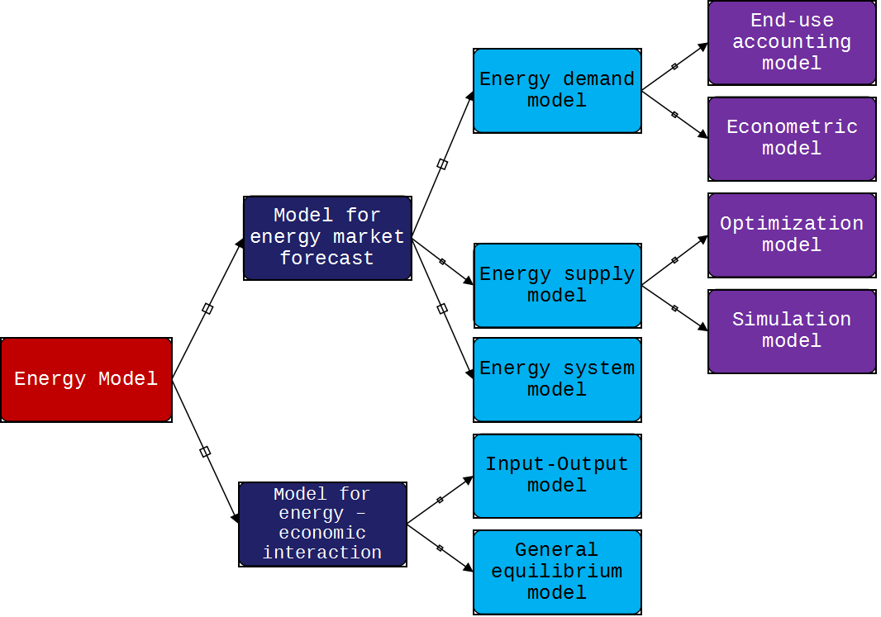
Energy Modelling Classification
There are many classifications of energy models, where it can be viewed from various aspects, among others, the objectives of the model used, the type of methodology, the mathematical approach used and so forth.
World Bank classify the model into two big groups, market forecasting and energy economic interaction

Slide 14
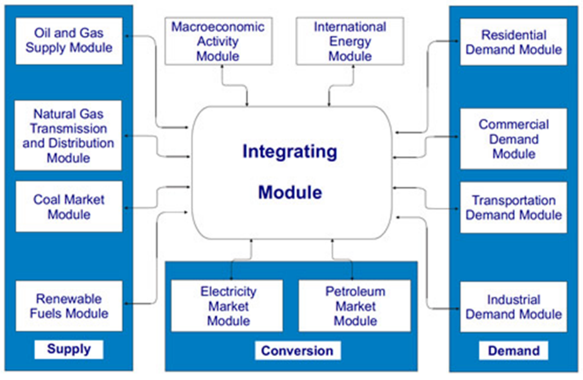
Model for Energy Market Forecasting (3)-Energy System Model/NEMS
Notes:
This model is a software tool used by the Energy Information Administration (EIA) in the United States since 1994 to forecast the US energy market and to analyze various economic, environmental and energy sovereignty policies. The NEM predicts production, import, conversion, consumption and energy prices which are subject to macroeconomic assumptions and financial factors, world energy markets, availability of resources and costs, criteria for behavior and technology selection, cost characteristics and performance of energy and demographic technology. Based on the results of the NEMS, the IEA publishes an energy outlook every year and is also used for various special analyzes at the request of the government, congress, energy department or other government agencies. The structure of the NEMS model is shown in Figure 5.8

Slide 15
Model for Energy and Economic Interaction (1)
Each choice of energy demand and supply balance scenario has a different impact on a country's economy. Impact analysis is important to get the most appropriate scenario. An energy plan will certainly have an impact on the macroeconomic structure, the growth rate of economic sectors, inflation, the country of trade and the balance of payments. Aside from economic impact analysis, another important analysis to do is environmental impact analysis. Both types of analysis are very important in any energy project. By using models to analyze and compare quantitative simulations of various policy possibilities, it is hoped that the government can identify the "best" policies or the best combination of policies, avoid inconsistent policies, and achieve optimal trade-offs from various objectives that might conflict with each other
The benefits of using a simulation model will be even greater if the model used is multisectoral, by distinguishing commodities that differ in consumption and production. This type of model is called the Economy Wide impact Model. Included in this model group are the input-output model, the Social Accounting Matrix (SAM) model and the Computable General Equilibrium (CGE) model.
Notes:
LEAP, developed by the Stockholm Environmental Institute, is a scenario-based energy accounting model. This model accommodates technology and environmental databases, energy demand is grouped according to sector, user subsector and equipment, in which there is also a transformation of the energy sector (electricity, refineries). The structure of the model from LEAP is shown in Figure 5.9
LEAP uses an accounting framework as an approach to get a view of energy demand (and supply) based on the physical description of the energy system. This model relies on a scenario approach to develop a consistent story line from the evolution of an energy system. So for the projected needs, this model does not optimize or simulate the portion of the market, but rather analyze the implications of possible alternatives of the market portion of demand (Batthacarya, 2010).

